Slide 1


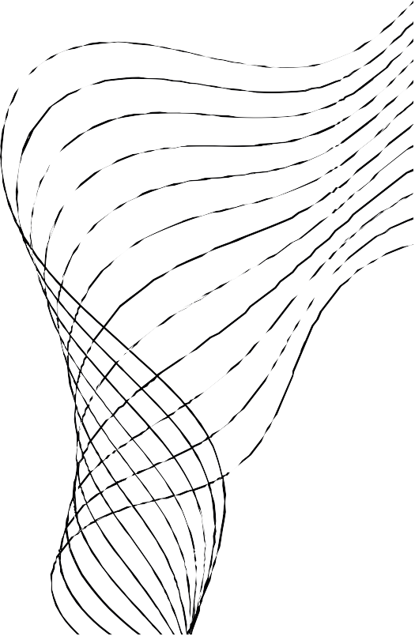
EASY WAY
WEBSITE
MAJOR PROJECT

Slide 2


CONTENT
01
02
03
04
05
06
07
ABOUT US
OUR TEAM
STRATEGY
OUR SERVICES
SYSTEM REQUIREMENT
TECHONOLOGY USED
CONCLUSION

Slide 3

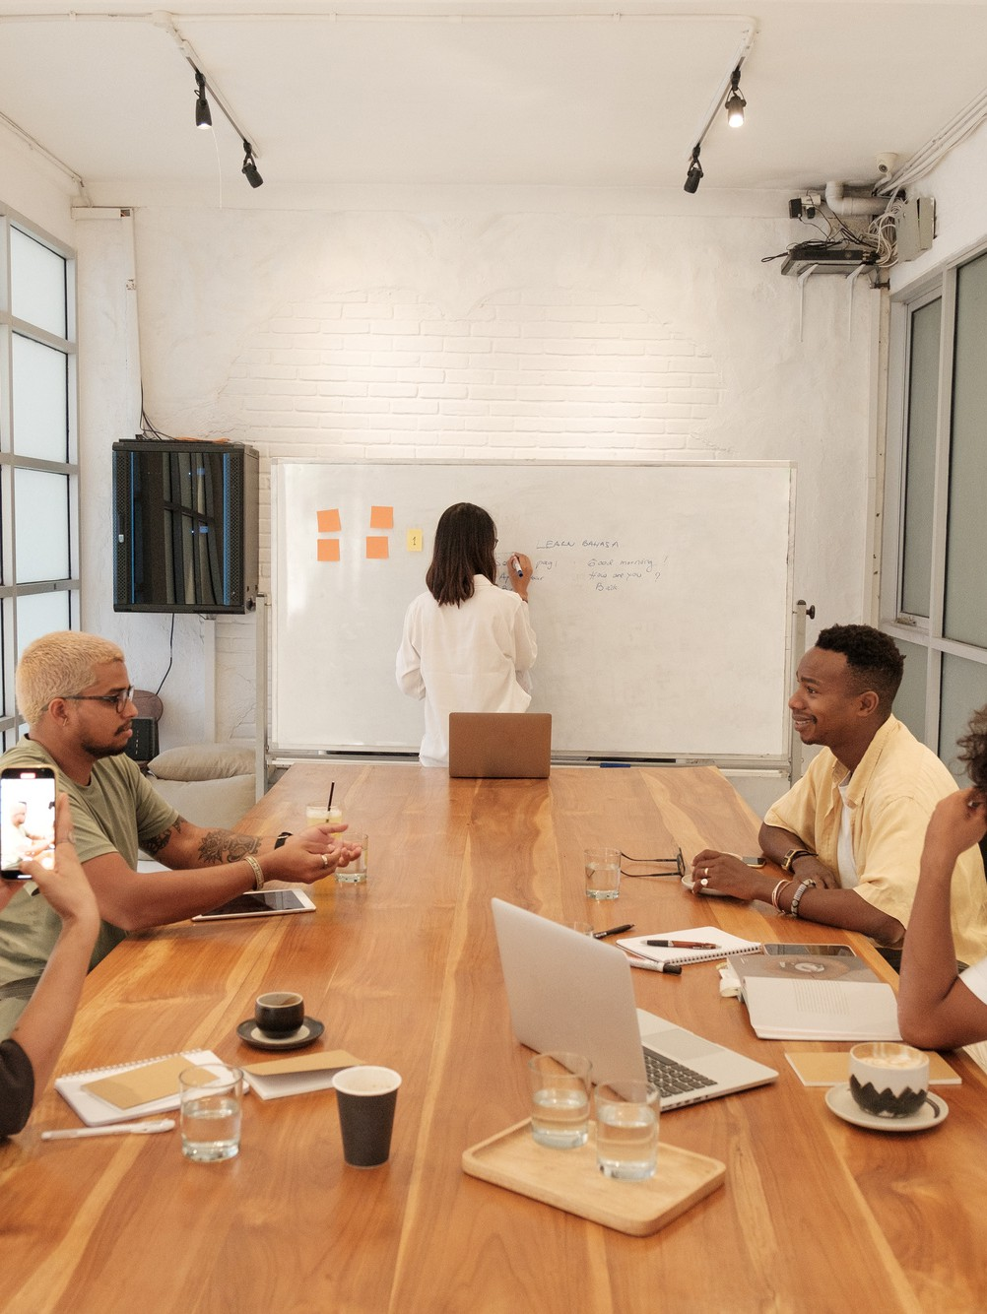




ABOUT US
Our project is developing a user-friendly online portal connecting users with local
workers for tasks l ike repairs and cleaning. It streamlines the process, making it easier for both users and workers, ultimately
improving their experience.
We' ve developed a user-friendly portal to digitize the local worker ecosystem,
streamlining the process of f inding reliabl workers for tasks l ike repairs, cleaning, an plumbing. By providing comprehensive
worker profiles, we aim to save time and frustration for both users and workers,
enhancing the overall experience for everyone involved.

Slide 4







OUR TEAM
Anshuman Patek
TL
(2200290140036)
Arpita vaish
Anshu Rajput
(2200290140038)
(2200290140035)

Slide 5


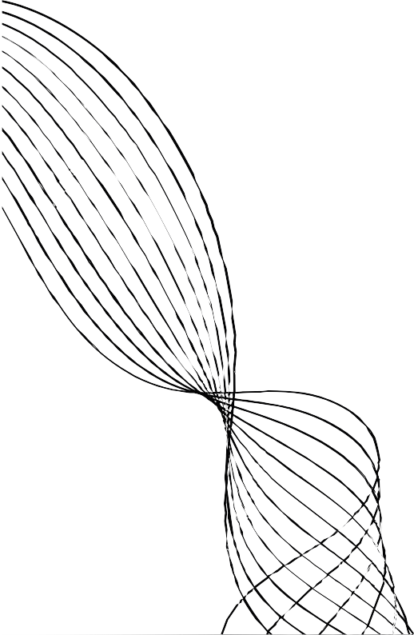
GOALS AND OBJECTIVES
Objective n° 1
Objective n° 2
Objective n° 3
Digitize the local
worker ecosystem to make it convenient for users to access a
database of local workers easily.
Provide comprehensive information about each worker, including experience and
ratings, to enable informed decision- making by users.
Improve the overall experience for both users and workers by
implementing an
efficient system for connecting them.

Slide 6


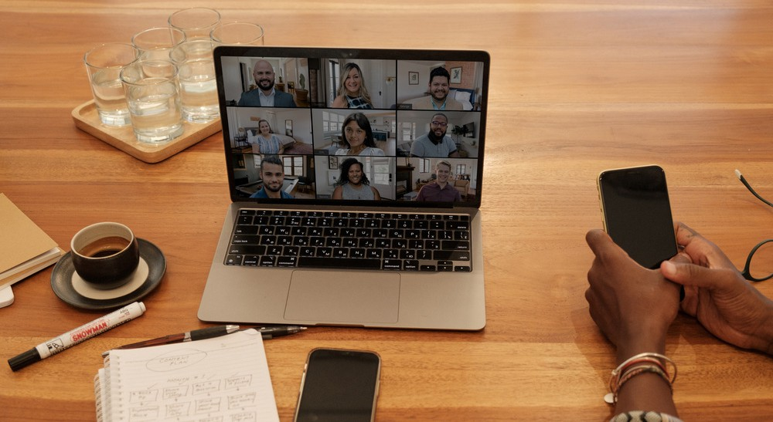

VALUES
Obįectives
Efficiency : Highlight how the portal saves time and
frustration by efficiently connecting users with suitable workers..
Convenience: Showcase the user-friendly interface of the portal, demonstrating how easy it is for users to
register and f ind local workers.
Values
Innovation: Highlight the innovative approach of digitizing the local worker ecosystem to address common challenges in f inding reliable workers..
User-Centric Design : Discuss how the portal is designed with the user' s needs in mind, offering a seamless
experience for both users and workers alike.

Slide 7


SYSTEM REQUIREMENT
Hardware Requirements
PC or Laptop
Hard Disk(Storage) -10GB or more (for project)
RAM (Memory)-2 GB or more (for smooth usage)
Processor
Modern process or(e. g. Intel Core i 3 or equivalent)
Software Requirements
Web Browsers – Google Chrome, Mozilla Firefox, Microsoft Edge, Safari
Code Editor – Visual Studio Code, Sublime Text, Atom, etc.

Slide 8
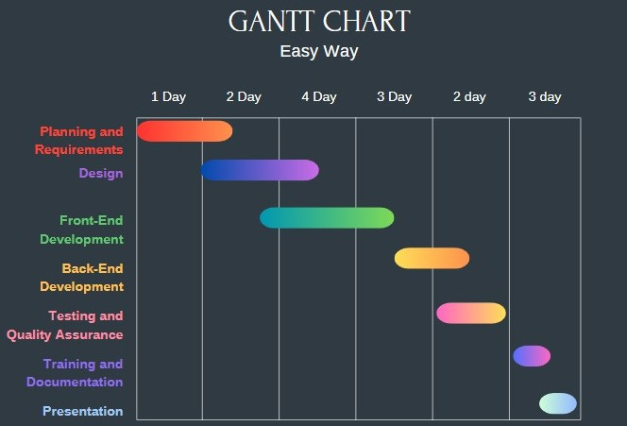


Slide 9




STRATEGIES
Our portal solves the
inefficiencies users and local workers face by offering easy access to a worker database, streamlining hiring processes, and improving overall
experiences.
PROBLEM- SOLUTION FOCUS
Our solution offers users rapid access to dependable workers, informed decision-making via worker profiles, and slashes
time spent on job searches, boosting efficiency and
satisfaction for all.
BENEFITS HIGHLIGHT
Our portal digitizes local worker interactions, boosting efficiency and economic growth while
continually enhancing user and worker experiences for lasting benefits.
DIGITAL
TRANSFORMATION AND FUTURE OUTLOOK

Slide 10
THANK YOU

